Slide 1
Introduction
CPSC 231:
Intro to Computer Science for
Computer Science Majors I
Fall 2023

Slide 2
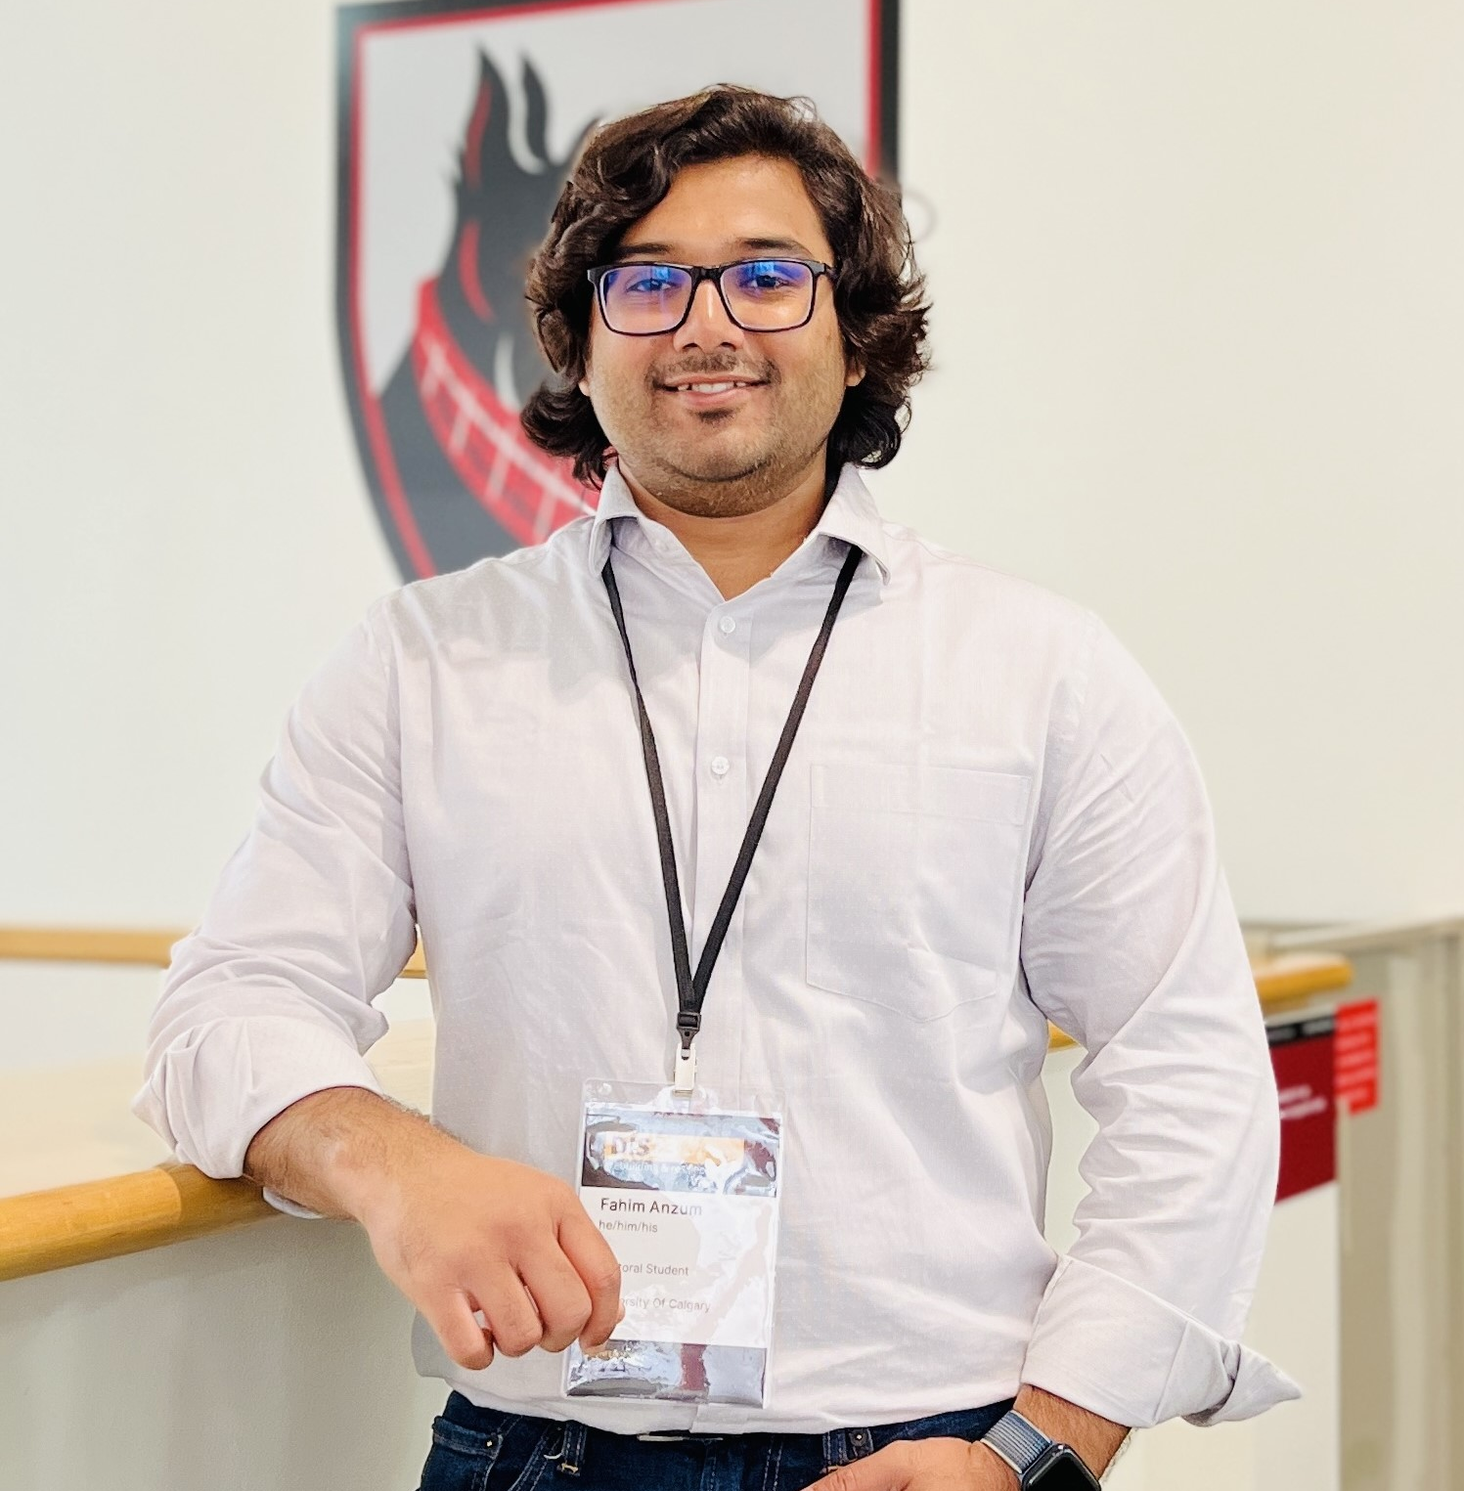
About Me
Instructor: Fahim Anzum, CPSC Ph.D. Candidate
Research Lab: The Biometric Technologies Lab (BT Lab)
Research interests:
Opinion mining
Online Social Media Trustworthiness
Machine learning, deep learning
Completed M.Sc. in Computer Science (Fall 2019 – Summer 2021)
Research Intern: Suncor Energy Inc.

Slide 3
Getting Connected
All slides will be uploaded on D2L
https://d2l.ucalgary.ca/
Under Section 03 Fahim Anzum section
Create an account in Tophat
Link: https://app.tophat.com/
Or search for tophat in App store
Please make sure using your Name and UCID that match with the University of Calgary records
Join the CPSC 231 course by using the code: 066729
You can also submit your answers via text messages to +1-647-931-6504
There will be bonus marks for class participation and Q&A

Slide 4
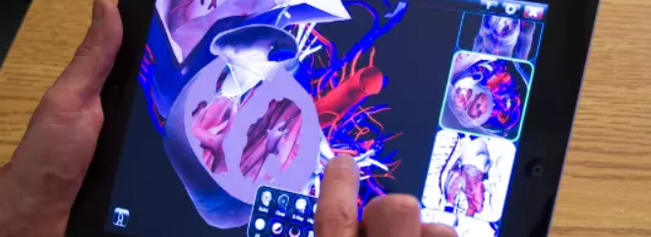
Computer Science
Computer science is about solving real world’s problems
Coding is just a “tool” for computer scientists, like a hammer for a construction worker
This course, CPSC 231, is about learning this tool
We will learn to use Linux, and coding in Python
Notes:
Real-world problems: Recommendation systems, Cybersecurity

Slide 5
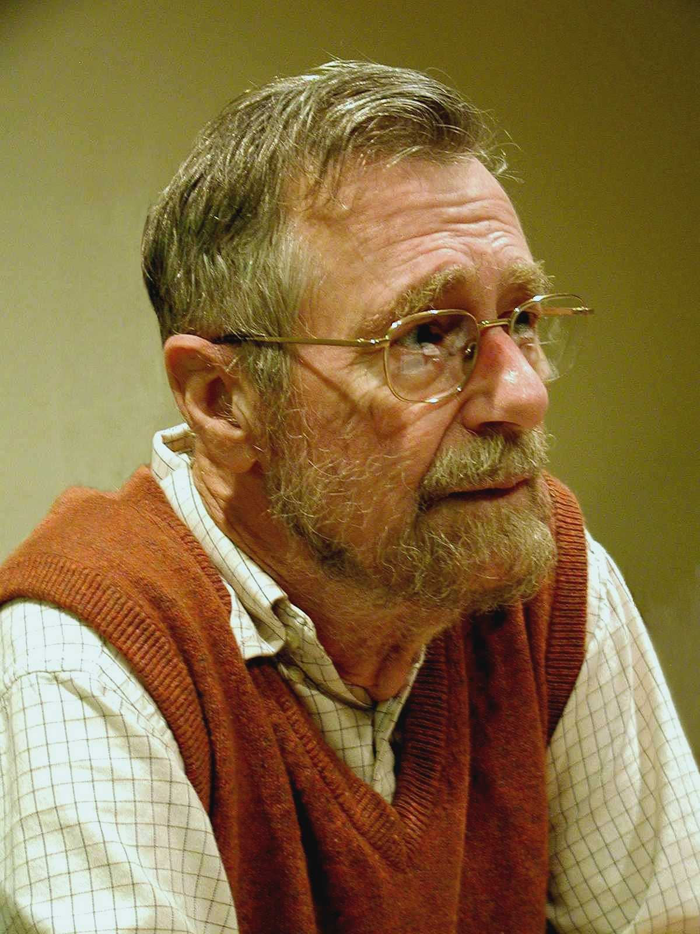
Computer Science
“Computer science is no more about computers than astronomy is about telescopes.”
Edsger Dijkstra
Portrait of Edsger W. Dijkstra Photograph by Hamilton Richards Licensed under the Creative Commons Attribution-Share Alike 3.0 Unported license
http://creativecommons.org/licenses/by-sa/3.0/deed.en
Notes:
Dijkstra is emphasizing that computer science is not limited to the hardware and physical devices we commonly associate with computers. Instead, it's primarily concerned with the broader concepts and principles like studying algorithms, data structures, problem solving methods, and many other theoretical and practical aspects of computation.

Slide 6
What is a Computer Scientist?
Computer scientists are scientists who happen to know how to use a computer to solve the world’s problems
However, computer scientists need to be good coders because you need to know how to effectively use your tools

Slide 7
What is a Computer Science degree?
First two years of computer science courses are about teaching you how to effectively use coding as a tool
Your third and fourth years are the actual exciting part of Computer Science – you learn how to use this tool for solving problems – in AI, in human-computer interactions, in graphics, in robotics, in security, in networks, etc…
Be warned, lots of math will be required

Slide 8

CPSC 231
Computational problem solving
The design and analysis of small-scale computational systems
Implementation of algorithms
This Photo is licensed under CC BY
Notes:
This course will provide you with the foundational knowledge and practical skills necessary for computational problem solving. We will cover both the theoretical aspects of designing and analyzing algorithms and the practical aspects of implementing those algorithms in problem solving.
Basically, this course is a fundamental building block for more advanced computer science courses.

Slide 9
CPSC 231
Lecture - Theory, Definitions, and Live Demos
Take notes in class
Tutorial (Lab) - TA will work with you on example problems and exercises
Starts next week
Your first source of help for anything related to the course
Your enrolled tutorial TA will mark your assignments and exams, so you need to go to your enrolled tutorial, not other tutorials

Slide 10


Q&A
Is lecture or tutorial attendance mandatory?
No.
You are an adult now. Nothing is mandatory.
But material discussed in them will be on the exams.

Slide 11
Q&A
What if I had to miss a lecture?
Ask a classmate for notes.
We also have a Discord server for this class.

Slide 12
Q&A
What other rules do you have in lecture?
Basically, do not disturb other students.
Don’t watch videos or play games on your computer in class.
If you have to leave during the lecture, quietly get up and quickly walk out.

Slide 13
CPSC 231
Website is on D2L
https://d2l.ucalgary.ca/
Course Information
Assignment submission
Lecture slides
Grades
Discussion board is on Discord
Invite Link on D2L

Slide 14

My office hours
Time: Tuesdays (12:30 – 2:30 PM)
Location: will be announced in D2L
What are office hours?
Drop-in hours instructors specifically set aside to get to know their students
You may:
Introduce yourself, have a quick chat
Discuss the class or school
Discuss your future options ( major, minor, concentrations, career choices, grad school, etc.)
Or anything else you think I could be of help

Slide 15
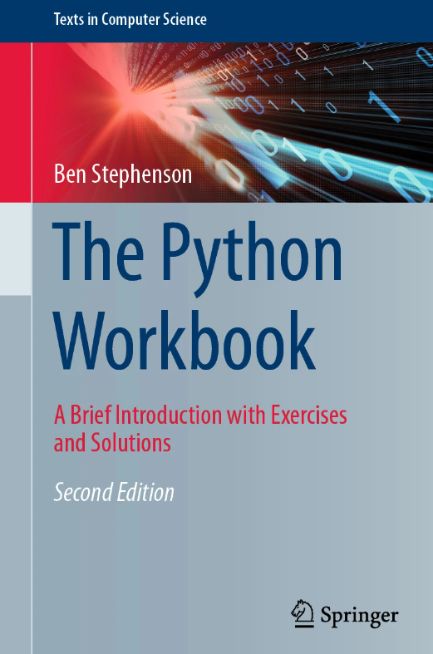
Textbook
The Python Workbook
Free pdf from the link on course website
FREE!

Slide 16
Grading
Assignment 1 3% of final grade
Exam 1 18%
Assignment 2 4%
Exam 2 18%
Assignment 3 4%
Exam 3 18%
Assignment 4 5%
Final exam 30%
Each assignment is a practice for an exam

Slide 17
Grading
Each assignment is a practice for an exam
Each exam is 50 minutes in your tutorial
Always start your assignments early.

Slide 18

Continuous Tutorial Help
During the week when an assignment is due:
Help from TAs will be available in the form of Continuous Tutorial (CT)
You can go to any TA (including TAs for different tutorials) for help on the assignment

Slide 19
Personal Days
Every student is given 5 personal days (sick days) this semester to use on assignments
Each personal day provides one assignment extension by 24 hours. No need to provide reason.
Extension to be requested using this form.
After all 5 personal days are used, an assignment will not be accepted unless there are exceptional circumstances (approved on a case-by-case basis)

Slide 20
Grading
Letter Grade | Grade Point Value | Description
A+ | 4.00 | Outstanding performance
A | 4.00 | Excellent performance
A- | 3.70 | Approaching excellent performance
B+ | 3.30 | Exceeding good performance
B | 3.00 | Good performance
B- | 2.70 | Approaching good performance
C+ | 2.30 | Exceeding satisfactory performance
C | 2.00 | Satisfactory performance
C- | 1.70 | Approaching satisfactory performance.
D+ | 1.30 | Marginal pass. Insufficient preparation for subsequent courses in the same subject
D | 1.00 | Minimal Pass. Insufficient preparation for subsequent courses in the same subject.
F | 0.00 | Failure. Did not meet course requirements.

Slide 21
Grading
Each of the components (assignments, exercises, exams) will be given a letter grade using the official University grading system.
The final grade will be calculated using the grade point equivalents weighted by the percentages of each component, and then converted to a final letter grade.

Slide 22
Q&A
What do these all mean?
Example: you received B+ on Assignment 2.
B+ is 3.3, so you received 3.3.
And Assignment 2 weights 4% of your final grade, so 3.3 x 4% is how much it counts towards your final grade.

Slide 23
Q&A
How about the final letter grade?
Example: you received 3.62 as the final calculated grade from all components (assignments, exams).
3.62 is between A- (3.7) and B+ (3.3) and is closer to A-, so you will receive A- as the final letter grade of this course.

Slide 24
Course Policies
Communications will be done through the official platforms:
@ucalgary.ca Email
D2L website
Instructor and TAs are expected to respond to emails within work hours.
That means – emails are not instant messages, and you should expect delayed replies on evenings and weekends.

Slide 25
Academic Misconduct
“A single offence of cheating, plagiarism, or other academic misconduct, on term work, tests, or final examinations, etc., may lead to disciplinary probation or a student's suspension or expulsion from the faculty by the Dean, if it is determined that the offence warrants such action. ”
All the work you submit must be your own.

Slide 26
Academic Misconduct
Cheating
e.g.
Copying another student’s answer on exams.
Using an electronic device during exams.

Slide 27
Academic Misconduct
Fabrication and Falsification
e.g.
Telling the instructor that your grandma died when she is very much alive
Making a fake ID

Slide 28
Academic Misconduct
Plagiarism
presenting the ideas, expression of ideas or work of another individual as your own
e.g.
Copying code from the internet
Copying code from another student
Letting someone else write your code

Slide 29
Academic Misconduct
Plagiarism
presenting the ideas, expression of ideas or work of another individual as your own
Treat Generative AI tools (ChatGPT, etc.) as another "individual." You can ask it to help you correct your mistake, but if the entire code is written by ChatGPT – it is treated as if you copied your code from another person.

Slide 30
Academic Misconduct
Unauthorized assistance
e.g.
Getting someone else to do your assignment, paid or unpaid
Getting someone else to pretend to be you to write your exam

Slide 31
Academic Misconduct
For us all, fairness is fundamentally important
Link to student handbook
For you own benefit: You need to understand all of the code in your work because
Coding is your tool for solving the world’s problems
No copying answers from the internet, from your classmates, or from your parents.

Slide 32
See you next class
Reminders:
No tutorials this week.
If you haven’t registered for an IT Account, please do so now:
https://itregport.ucalgary.ca/
If you have an @ucalgary.ca email, you have an IT Account.

Slide 33
Credits
Content created and adapted for CPSC 231 by Jonathan Hudson and Richard Zhao.

